Slide 1
Essential considerations for developing a “truly” sustainable design
Isra Saeed, PhD Candidate in Sustainability Management

Slide 2
About me
PhD Candidate in Sustainability Management
Master of Electrical Engineering (MEng) specialization in Sustainable Energy
Engineering → Social Sciences
Study the socioeconomic impacts of electricity sector transformations
Public enemy #1 today → cheering for Morocco

Slide 3
is there a Difference between the words ‘Environmental’ and ‘Sustainable’?

Slide 4
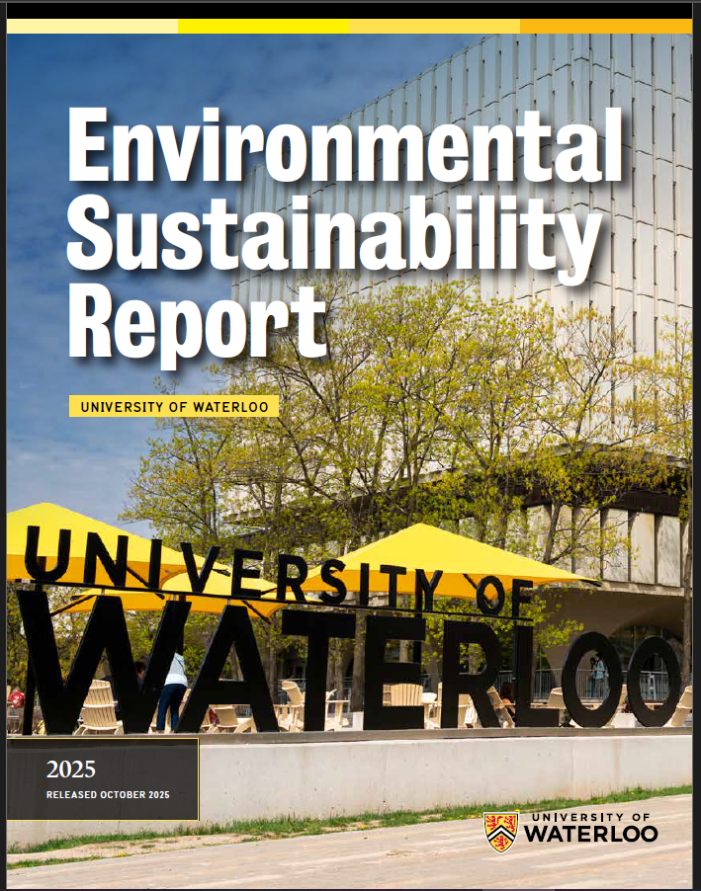
Is there a difference between the words ‘environmental’ and ‘sustainable’?
“Sustainability refers to maintaining the integrated health of the environment, society, and economy for today and into the future. While this report focuses primarily on environmental indicators, it recognizes that there are mutually reinforcing connections with financial and social sustainability.” source: (Office of Sustainability University of Waterloo, 2025, p. 5)
Notes:
Website source: Our progress | Sustainability | University of Waterloo. (n.d.). Retrieved July 4, 2026, from https://uwaterloo.ca/sustainability/our-progress
Present the definition of sustainability as included in University of Waterloo’s Environmental Sustainability Report
Environmental pertains to the natural world, the ecosystems - eg planting trees

Slide 5
Is there a difference between the words ‘environmental’ and ‘sustainable’?
“Sustainability refers to maintaining the integrated health of the environment, society, and economy for today and into the future. While this report focuses primarily on environmental indicators, it recognizes that there are mutually reinforcing connections with financial and social sustainability.” source: (Office of Sustainability University of Waterloo, 2025, p. 5)
Notes:
Website source: Our progress | Sustainability | University of Waterloo. (n.d.). Retrieved July 4, 2026, from https://uwaterloo.ca/sustainability/our-progress
Present the definition of sustainability as included in University of Waterloo’s Environmental Sustainability Report
Provide an example that highlights the difference between the two
Environmental pertains to the natural world, the ecosystems - eg planting trees
Sustainability is more inclusive an umbrella term that covers – environment, society, economy (medium term – long term)

Slide 6
Is there a difference between the words ‘environmental’ and ‘sustainable’?
“Sustainability refers to maintaining the integrated health of the environment, society, and economy for today and into the future. While this report focuses primarily on environmental indicators, it recognizes that there are mutually reinforcing connections with financial and social sustainability.” source: (Office of Sustainability University of Waterloo, 2025, p. 5)
Notes:
Website source: Our progress | Sustainability | University of Waterloo. (n.d.). Retrieved July 4, 2026, from https://uwaterloo.ca/sustainability/our-progress
Present the definition of sustainability as included in University of Waterloo’s Environmental Sustainability Report
Ask students to think about the term “mutually reinforcing connections” and continue asking questions until they reach the conclusion that the ‘best environmental solution is not always the optimal choice for sustainability’

Slide 7
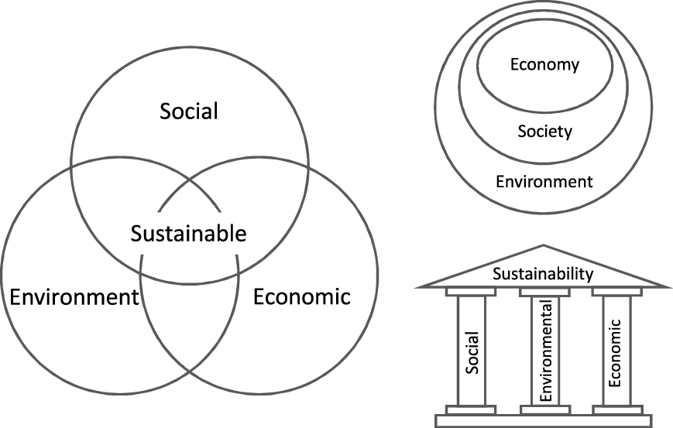
Three Pillars of Sustainability
Image source: (Purvis et al., 2019)
Notes:
Image source: Purvis, B., Mao, Y., & Robinson, D. (2019). Three pillars of sustainability: In search of conceptual origins. Sustainability Science, 14(3), 681–695. https://doi.org/10.1007/s11625-018-0627-5
Best solutions are usually the ones that optimize all three

Slide 8
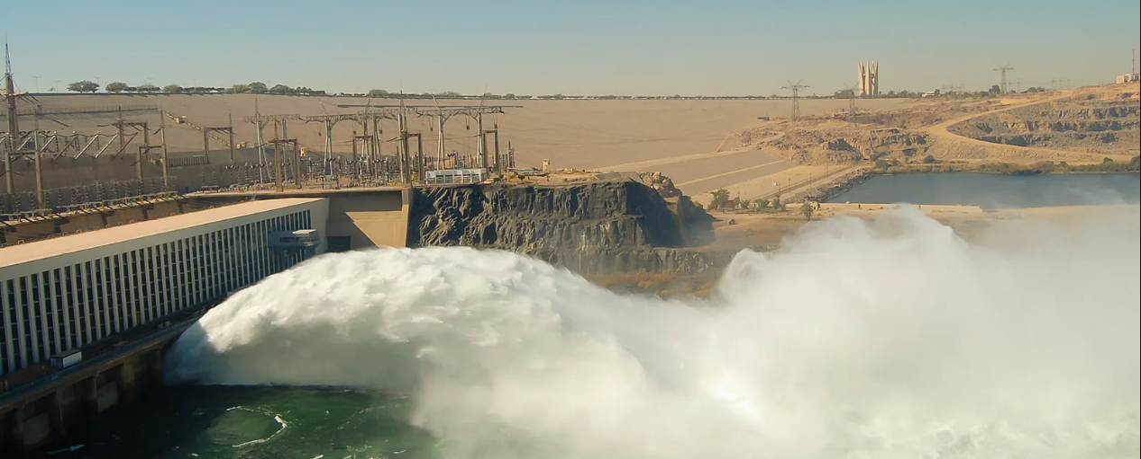
Example: Aswan Hydroelectric Dam in EGYPT
Image source: (Aswan High Dam | Description, History, Capacity, Problems, & Facts | Britannica, n.d.)
Notes:
Image source: Aswan High Dam | Description, History, Capacity, Problems, & Facts | Britannica. (n.d.). Retrieved July 4, 2026, from https://www.britannica.com/topic/Aswan-High-Dam

Slide 9
What is the most difficult pillar to account for and why
Cont. example: Constructing the dam → (A) social impact
What do we do? Think of every possible scenario?!
Reduce complexity by asking questions around scope and priority
Notes:
Video sources (in order of appearance on slides) :
Al Jazeera English. (2012, June 10). Egypt’s Nubians seek return to homeland [Video recording]. https://www.youtube.com/watch?v=MNxJFac-lb8
British Movietone. (2015, July 21). ASWAN DAM PROJECT [Video recording]. https://www.youtube.com/watch?v=Hi8CIa5jlrI
Explain ways that could help reduce the complexity of the social component:
e.g. which groups should we consider? Those on campus or all residents of KW? I
focusing on campus, should we account for the impacts on both current and future students?
Which factors matter most to present and future campus demographics? Cost, convenience and accessibility, noise, aesthetic appeal, etc.

Slide 10
How do we go about the challenge?
Group: Team of consultants
Client: University of Waterloo
Requirements: Judging Rubric

Slide 11
Goal
Design a solution that checks off your client’s requirements. If design trade offs are made, highlight it to your client and explain the rationale behind your decision to compromise on one criterion over the others.

Slide 12
Thank you!

Slide 13
Questions?

